Slide 1


2019 ACT & SAT Scores: Schools with High Free & Reduced-Price Meals, California
Brandie Hatch

Slide 2


Brandie Hatch
Data Scientist and Learning Specialist
M. Ed. Information Science and Learning Technologies
http://brandiehatch.com/
https://www.linkedin.com/in/brandiehatch/
Passionate about learning and food security.
Notes:
Presentation will be geared towards grant program and state education budget decision makers for grant eligibility determination and program funding.

Slide 3
Problem
Confirm hypothesis that students in low-income schools are not meeting/exceeding the benchmark for SAT Math, Evidence-Based Reading & Writing (ERW), and ACT composite scores of 21 or more.
Identify schools with the most participants in the Free or Reduced-Priced Meal (FRPM) program.
Compare to twelfth grader’s scores on the ACT and SAT.
Provide findings to Title I and other program leaders so they can determine funding or grant eligibility.
Grants and funding sources could help improve ACT and SAT scores of students from low-income families and help ensure that all students meet challenging state academic standards.
Notes:
This project aims to identify the schools with the most Free and Reduced-Priced Meal (FRPM) program participation and the twelfth grader’s aggregate scores on the ACT and SAT so that Title I program leaders can determine funding or grant eligibility. These grants and funding could help improve ACT and SAT scores of children from low-income families to help ensure that all children meet challenging state academic standards.
Project hypothesis: students in low-income schools are not meeting/exceeding the benchmark for SAT Math, Evidence-Based Reading & Writing (ERW), and ACT composite scores. This project aims to explore a possible correlation between the schools with the most Free and Reduced-Priced Meal participation and their scores on the ACT and SAT so that Title I program leaders can determine funding or grant eligibility. These grants and funding sources could help improve ACT and SAT scores of children from low-income families to help ensure that all children meet challenging state academic standards.

Slide 4
Background Information

Slide 5


Free and Reduced Price Meals
Title I, Part A of the Elementary and Secondary Education Act:
provides financial assistance to local educational agencies and schools with high numbers or high percentages of children from low-income families
to help ensure that all children meet challenging state academic standards
Notes:
Is often used as an indicator of low-income status for the students and families.
Title I, Part A of the Elementary and Secondary Education Act provides financial assistance to local educational agencies and schools with high numbers or high percentages of children from low-income families to help ensure that all children meet challenging state academic standards.

Slide 6
Student Eligibility for FRPM
Free Meals
Family income below 130% of the poverty level
Reduced Price Meals
Family income 130-185% of poverty level
Direct Certification
Free meals if household receives federal food security benefits
2019 California Poverty Level: $35,600 per year for a family of four
Notes:
Supplemental Nutrition Assistance Program (SNAP),
Temporary Assistance for Needy Families (TANF),
Food Distribution Program on Indian Reservations (FDPIR)
children who are:
Migrant
Homeless
In foster care

Slide 7
Healthy, Hunger-Free Kids Act 2010
The Healthy, Hunger-Free Kids Act 2010 (HHFKA) increased food access for schools in low-income areas.
All students in low-income areas are provided free meals.
Low-income area schools are certified as eligible if 95% of families receive Supplemental Nutrition Assistance Program (SNAP) benefits.
NOTE: The HHFKA limits the usefulness of the data provided by California.
Notes:
Schools may report all students as eligible for FRPM regardless of economic status, since all students are provided free meals.

Slide 8
ACT and SAT
Exams Goal: to gauge readiness for college
Number of Students Who Took Exam:
ACT: 1.78 million
SAT: 2.2 million
Cost for exams:
ACT $50.50 - $67.00 (with writing)
SAT $47.50 - $64.50 (with essay)
Critics of standardized tests say the tests create disadvantages for minority and low-income college applicants, as many wealthier students pay for pricey preparation courses that help to increase their scores — and chances of getting into better universities.
- Cal State says no need for SAT, ACT 2022
Notes:
Both exams are used to gauge readiness for college.
Class of 2019 exams:
ACT: 1.78 million students
SAT: 2.2 million students
Cost for exams:
ACT $50.50 - $67.00 (with writing)
SAT $47.50 - $64.50 (with essay)

Slide 9
Investigative Process
SAT
ACT
FRPM
Low-income Student Scores per School
Utilizing data from the state of California:
2019 ACT and SAT scores
Free or Reduced-Price Meals (FRPM) School-level data, 2018-19 school year
Comparing the FRPM eligible students K-12 data with the ACT and SAT scores based on School Codes.

Slide 10
Primary Findings

Slide 11
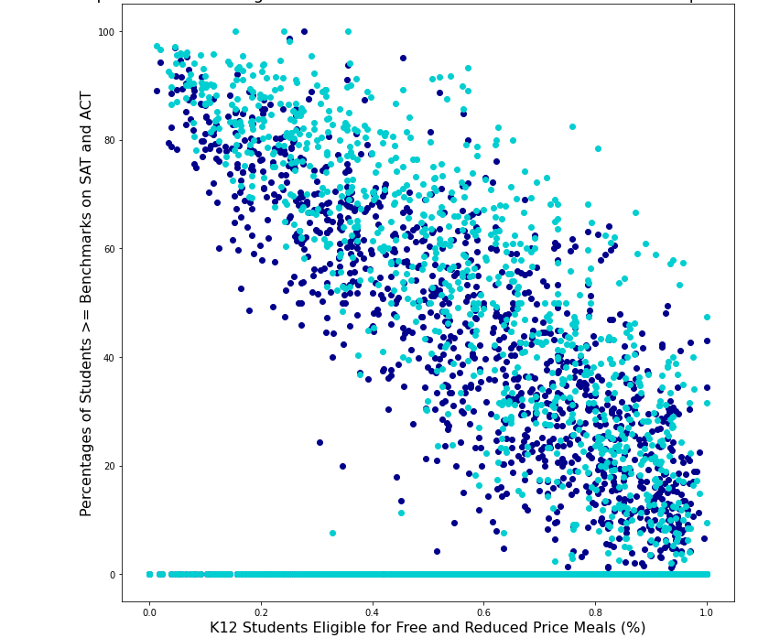
Increased FRPM Eligibility Typically Means Lower Scores
Notes:
As school’s edibility for FRPM increases, their test scores decrease.

Slide 12
Increased FRPM Eligibility Typically Means Lower Scores
Notes:
As school’s edibility for FRPM increases, their test scores decrease.

Slide 13
Five Schools with the Highest FRPM Eligibility and Lowest Number of Students to Exceed Exam Benchmarks
School Name | Students Enrolled at School | Number Eligible FRPM | ACT: Number of Test Takers | ACT: Number of Student Scores >= 21 | ACT: Percentage of Student Scores >= 21 | SAT: Number of Test Takers | SAT: Number of Student Meet Benchmark | SAT: Percent of Student Meet Benchmark
Mira Monte High | 2468 | 2280 | 13 | 0 | 0 | 174 | 29 | 16.67
Katella High | 2718 | 2199 | 18 | 7 | 38.89 | 199 | 42 | 21.11
Eisenhower Senior High | 2360 | 2173 | 63 | 15 | 23.81 | 124 | 35 | 28.23
Palmdale High | 2523 | 2049 | 24 | 6 | 25 | 108 | 17 | 15.74
South High | 2161 | 2031 | 31 | 9 | 29.03 | 152 | 37 | 24.34

Slide 14
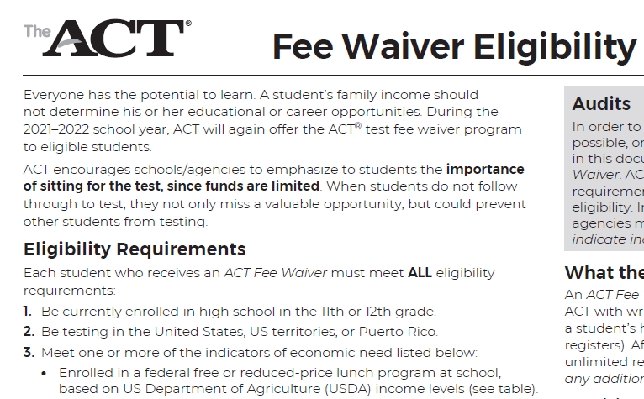
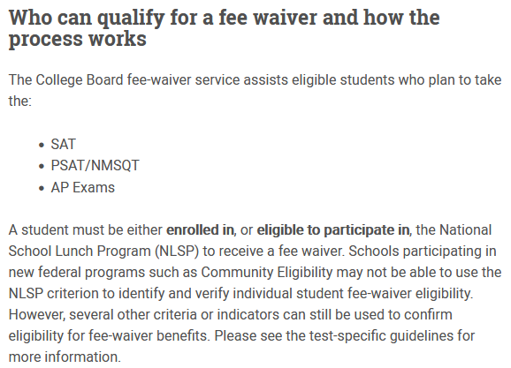

ACT and SAT Fee Waivers
Even with fee waivers, students may not be able to afford the preparatory practice tests which continues to put their peers at an advantage.
Notes:
Even with fee waivers, students may not be able to afford the preparatory practice tests which continues to put their peers at an advantage.

Slide 15
Conclusions and Recommendations

Slide 16
Provide Funding for Schools with High Free and Reduced-Price Meal Eligibility
In conclusion, there is a correlation between students who are eligible for Free and Reduced-Price Meals and those students who score low on the ACT or SAT. Additionally, many eligible students do not even take the ACT or SAT.
I recommend that the ACT and SAT exam provide give free access to the tests for all students in FRPM eligible schools and for all students who are eligible for FRPM in any school. Make the free assessments as accessible as possible for students eligible for FRPM so that it is easy to take the assessments.
Additionally, I recommend that the State of California, the Federal Government, and other funding providers continue to provide financial assistance to the schools and districts with the most participants in the Free or Reduced-Priced Meal (FRPM) program. This would include funding to provide study resources and practice test opportunities.

Slide 17
Further Considerations
Propose a 3-year study to research and model a handful of schools that have been given funding for exam preparation with waived fees to if the outcome provides increased test scores.

Slide 18
Sources
Income Eligibility Guidelines can be found from the Food and Nutrition Service Agency of the United States of America.
Free or Reduced-Price Meal School-level Data and Data Dictionary can be found on the California Department of Education website.
U.S. Department of Education Title I, Part A website: https://www2.ed.gov/programs/titleiparta/index.html
National Center for Education Statistics: https://nces.ed.gov/blogs/nces/post/understanding-school-lunch-eligibility-in-the-common-core-of-data
No Kid Hungry: Center for Best Practices: https://bestpractices.nokidhungry.org/

Slide 19
Questions
http://brandiehatch.com/
https://www.linkedin.com/in/brandiehatch/

